Slide 1
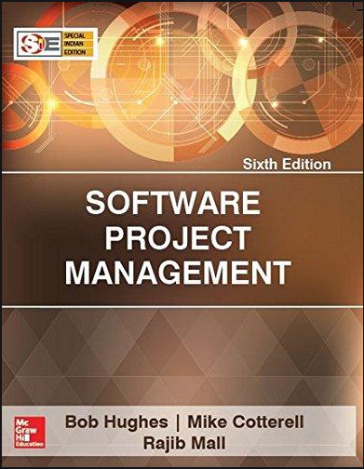
Software Project Management
6th Edition
Chapter 1
An Introduction
Robert Hughes and Mike Cotterell

Slide 2
About the course
3 Credits
Audience:
Software Engineering
Computer Science Technology
Information Management
Previous Courses:
Software Engineering
Principle of Management
Text book
By Bob Hughes and Mike Cotterell
6th Edition
PM BoK 5th/6th Edition

Slide 3
Course Organization
1. Introduction to SPM
2. PM Tools
3. PMI Framework / Knowledge Areas
4. Organizational Structures
5. Project Planning
6. Project Evaluation
7. Approaches to Project Management
8. Software Effort Estimation Techniques
9. Activity Planning
11. Configuration Management
10. Risk Management
12. Resource Management
13. Monitoring & Control
14. Review & Evaluation

Slide 4
Objectives – Lecture 1
Software Project Versus Other Type of Projects
Dimensions of a Software Project
Activities in SPM
Setting Goals & Objectives
Business Case
Significance of Processes
Project Vs. Program Management
Notes:
The two key questions are:
What exactly is software project management?
This is going to be tackled by looking firstly at what is meant by ‘project’. We are then going to examine whether ‘software project management’ is really different from ‘normal’ project management. Is there anything special about software as opposed to other engineered artefacts?
2. How do we define whether a project is a success or not?
The point about studying project management is to be able to have successful projects. So how do we know if we have been successful?

Slide 5
Outline of talk
In this introduction the main questions to be addressed will be:
What is software project management? Is it really different from ‘ordinary’ project management?
How do you know when a project has been successful? For example, do the expectations of the customer/client match those of the developers?
Notes:
The two key questions are:
What exactly is software project management?
This is going to be tackled by looking firstly at what is meant by ‘project’. We are then going to examine whether ‘software project management’ is really different from ‘normal’ project management. Is there anything special about software as opposed to other engineered artefacts?
2. How do we define whether a project is a success or not?
The point about studying project management is to be able to have successful projects. So how do we know if we have been successful?

Slide 6
Management
Management is the organization and coordination of the activities of a business in order to achieve defined objectives.
Management includes the activities of setting the strategy of an organization and coordinating the efforts of its employees (or of volunteers) to accomplish its objectives through the application of available resources, such as financial, natural, technological, and human resources.

Slide 7
Project management
Project management is the practice of initiating, planning, executing, controlling, and closing the work of a team to achieve specific goals and meet specific success criteria at the specified time.
The primary challenge of project management is to achieve all of the project goals within the given constraints

Slide 8
Who is a Project Manager???
A project manager is a person who has the overall responsibility for the successful initiation, planning, design, execution, monitoring, controlling and closure of a project.
Qualities:
Effective communication skills
Strong leadership skills
Good decision maker
Technical expertise
Inspires a shared vision
Team-building skills
Cool under pressure

Slide 9
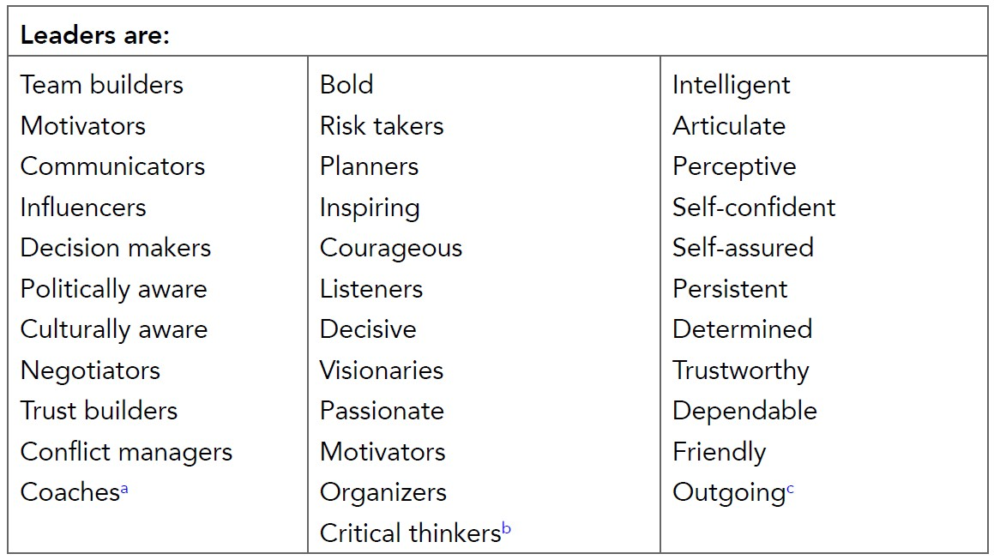
Leadership Attributes

Slide 10
Role of PM
🠶 Leadership
🠶 Motivation
🠶 Team building
🠶 Negotiation
🠶 Conflict management

Slide 11
Software Project Management
It is a sub-discipline of project management in which software projects are planned, implemented, monitored and controlled

Slide 12
Importance of SPM
Why it is important to become familiar with project management?
First there is a question of money. A lot of money is at stake with ICT projects.
Secondly, the projects are not always successful, studies show that only one third of software projects were proved to be successful.
The reason for these project shortcomings is most often the management of software projects.

Slide 13
Why is SPM important?
Unfortunately, projects are not always successful.
Standish Group in the U.S. analyzed 13,522 projects and concluded that only a third of them were successful; 82 percent were late and 43 percent exceeded their budget.
The reason for these project shortcomings is often the management of projects.

Slide 14
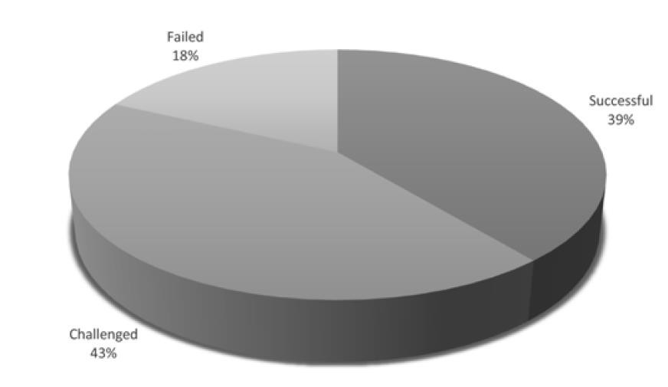
IT Projects outcome

Slide 15
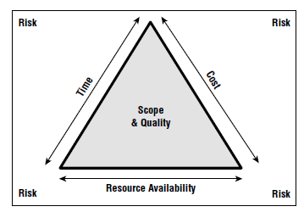
Scope Triangle

Slide 16
“Tip”
🠶 “ Work Smart, not hard”

Slide 17
What is SPM?
🠶 Maintain flow
🠶 Manage outcomes (Deliverables)
🠶 Use tools and techniques
🠶 Improve operation
🠶 New requirement
🠶 Aim is to achieve all the objectives remaining in its define constraint
🠶 Time
🠶 Cost
🠶 Scope

Slide 18
Project Vs Process (Operation)
🠶 Definite time
🠶 Resources
🠶 Budget
🠶 Deliverable parameters
🠶 Has an end
🠶 Need to update an operation (Operation) that result in some deliverable.

Slide 19
What is a project?
Some dictionary definitions:
“A specific plan or design”
“A planned undertaking”
“A large undertaking e.g. a public works scheme”
Longmans dictionary
Key points above are planning and size of task
Notes:
Here are some definitions of ‘project’. No doubt there are other ones: for example
‘Unique process, consisting of a set of coordinated and controlled activities with start and finish dates, undertaken to achieve an objective conforming to specific requirements, including constraints of time, cost and resources’
BSO ISO 10006: 1997

Slide 20
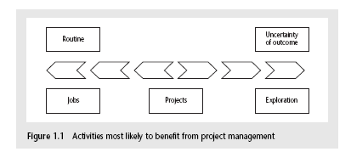
Jobs versus projects
‘Jobs’ – repetition of very well-defined and well understood tasks with very little uncertainty
‘Exploration’ – e.g. finding a cure for cancer: the outcome is very uncertain
‘Projects’ – in the middle!
Notes:
On the one hand there are repetitive jobs a similar task is carried out repeatedly, for example Kwikfit replacing a tyre on a car or a lecturer giving an introductory talk on project management. The task is well-defined and there is very little uncertainty. In some organizations, software development might tend to be like this – in these environments software process management might be more important than software project management
On the other hand some exploratory activities are very uncertain. Some research projects can be like this – we may not be sure what the outcome will be, but we hope that we will learn some things of importance. It may be very difficult to come up with precise plans, although we would probably have some idea of a general approach.
Projects seem to come somewhere between these two extremes. There are usually well-defined hoped-for outcomes but there are risks and uncertainties about achieving those outcomes.

Slide 21
Definition of a Project
A project is a temporary endeavor undertaken to create a unique product, service, or result.(PMBoK)
A project is defined as “a temporary organization that is created for the purpose of delivering one or more business products according to an agreed Business Case.” (PRINCE 2)

Slide 22
Project
Characteristics that distinguish projects:
Non-routine tasks
Planning is required
Specific objectives are to be met
Pre determined time span
Work involves several specialisms
A temporary work group is formed
Work is carried out in several phases
Resources are constrained
Large or complex

Slide 23
Activity 1
Put following into an order such that most closely matching to what constitutes a project is at top of the list.
Producing an edition of a newspaper
Putting a robot vehicle on mars
Amending a financial computer system to deal with a common European currency
An investigation into the reason why a user has a problem with a computer system
A programming assignment for a computing student.

Slide 24
Are software projects really different from other projects?
Not really! …but…
Invisibility: With software, progress is not immediately visible
Complexity: Per dollar, software products contain more complexity than other engineered artefacts
Conformity: Software developers have to conform to the requirements of human clients
Flexibility: Software systems are particularly subject to change
Notes:
This is based on Fred Brooks’ paper No Silver Bullet: Essence and Accidents of Software Engineering which appeared in IEEE Computer 20(4) pp10-19 April 1987

Slide 25
Activities covered by project management
A software project is not only concerned with the actual writing of software. In fact, where a software application is bought in “of the shelf”, there may be no software writing as such, but this is still fundamentally a software project because so many of the other activities associated with software will still be present.
Three successive processes
Notes:
There are twAssesses whether a project is worth starting
Information is gathered about the requirements of the proposed application and this process can be complex and difficult.
Developmental and operational costs are estimated
Benefits of new systems will be estimated
o key points here.
Planning
If feasibility study indicates the project as worthy, planning starts
Normally a complete detailed plan is created for smaller projects.
For larger projects, an outline plan for whole project and a detailed one for the first stage will be created.
Project Execution
Execution often contains design and implementation sub phases.
Design is making desicions about the form of the products to be created.
External appearance of the software, UI.
Plan details the activities to be carried out to create the products.
Often you see something like ‘feasibility study’ being put as the first stage of development life cycle, and indeed it might be. However, the outcome of the feasibility study might be not to carry out the proposed project. Planning of the project should therefore take place after the feasibility study (or as a part of the feasibility study perhaps). Clearly the feasibility study itself might need a plan.
All plans are to some extent provisional and subject to change. The key point is that the evolving plan allows us to control the project.

Slide 26
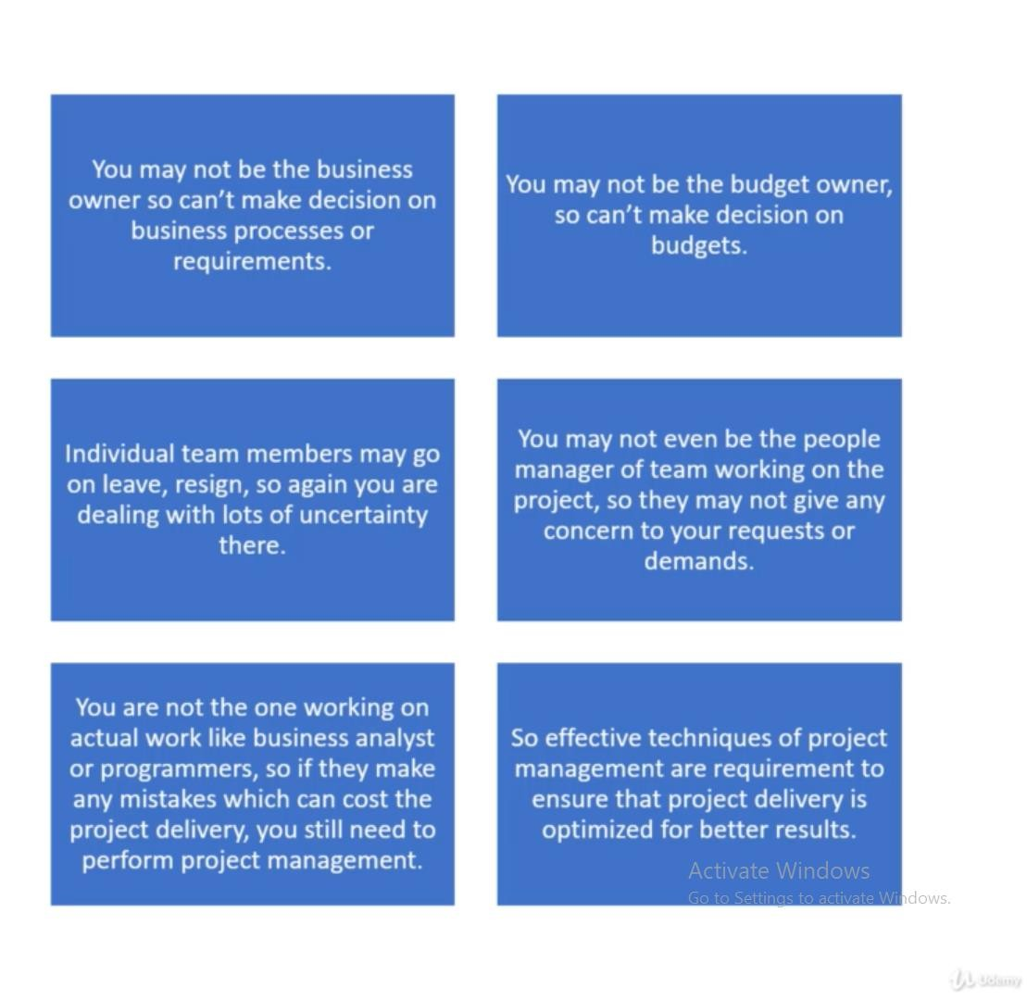
Common Challenges

Slide 27
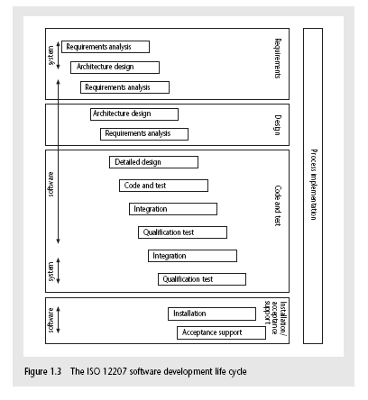
The software development life-cycle (ISO 12207)
Notes:
This section of the lecture discusses the software development life cycle. Note that this is a technical model. It identifies the technical constraints on the order activities are done. This does NOT imply that a ‘waterfall’ approach is the only way to organize projects. The technical model could be implemented as increments or in an evolutionary manner.

Slide 28
ISO 12207 life-cycle
Requirements analysis
Requirements elicitation: what does the client need?
Analysis: converting ‘customer-facing’ requirements into equivalents that developers can understand
Requirements will cover
Functions
Quality
Resource constraints i.e. costs
Notes:
The key point here is that requirement analysis has to face in (at least) two different directions. It needs to communicate and elicit the requirements of the users, speaking in their language. It needs to organize and translate those requirements into a form that developers can understand and relate to.

Slide 29
ISO 12207 life-cycle
Architecture design
Based on system requirements
Defines components of system: hardware, software, organizational
Software requirements will come out of this
Code and test
Of individual components
Integration
Putting the components together
Notes:
The software project will almost certainly be part of a larger project which has non-software elements. In a software engineering environment it could be the software will be embedded in hardware product of some kind. Thus there are system requirements for the product as a whole and software requirements for the software element.
In a business information systems environment, the software development could be a relatively minor part of a much larger organizational change project.

Slide 30
ISO12207 continued
Qualification testing
Testing the system (not just the software)
Installation
The process of making the system operational
Includes setting up standing data, setting system parameters, installing on operational hardware platforms, user training etc
Acceptance support
Including maintenance and enhancement
Notes:
The confusion about what ‘implementation’ really means could be mentioned. Does it mean implementing the design (that is, coding) or implementing the complete system in its user environment? It is best to use ‘installation’ to describe the latter in order to avoid confusion.

Slide 31
Some ways of categorizing projects
Compulsory vs. voluntary users
Supermarket transaction system vs. computer game
Information systems vs. embedded systems
Office system vs. machine control system
Objectives vs. products
to meet certain objectives vs. to produce a product.
Notes:
With objective-based projects, a general objective or problem is defined, and there are several different ways in which that objective could be reached. The project team have freedom to select what appears to be the most appropriate approach.
With product-based projects, the product is already very strictly defined and the development team’s job is to implement the specification with which they have been presented.
Arguably, information systems projects are more likely to be objective-based than is the case with software engineering.
In many cases, an objective-based project could consider a problem and recommend a solution that is then implemented by a product-based project.
Exercise 1.5 in the text is relevant here.

Slide 32
Setting objectives
Answering the question ‘What do we have to do to have a success?’
Need for a project authority
Sets the project scope
Allocates/approves costs
Could be one person - or a group
Project Board
Project Management Board
Steering committee
Notes:
Different people who are involved in a project (Stakeholders) will have different interests in the project and are likely to see different outcomes as being important.
For example, end-users would want a system that is ‘user-friendly’, that is, easy to learn and to use, and a system that helps rather than hinders them from doing their jobs. Their managers may be more interested in whether the new system would allow them to reduce staffing levels.
It is important therefore that a set of clearly defined objectives are identified and published for the project. Some individual or group needs to be pinpointed who acts as the main client for the project.
See Exercise 1.7 in the text.

Slide 33
Objectives
Informally, the objective of a project can be defined by completing the statement:
The project will be regarded as a success if………………………………..
Rather like post-conditions for the project
Focus on what will be put in place, rather than how activities will be carried out
Notes:
The focus here needs to be on what the situation will be when the project is completed. In what ways will the world be different? The objectives should avoid describing activities:
e.g. ‘a new payroll application will be operational by 4th April’ not ‘design and code a new payroll application’

Slide 34
Objectives should be SMART
S – specific, that is, concrete and well-defined
M – measurable, that is, satisfaction of the objective can be objectively judged
A – achievable, that is, it is within the power of the individual or group concerned to meet the target
R – relevant, the objective must relevant to the true purpose of the project
T – time constrained: there is defined point in time by which the objective should be achieved
Notes:
I have seen some places where the R is said to stand for ‘resource-constrained’, that is that there is a target cost associated with the achievement of the objective.

Slide 35
Goals/sub-objectives
These are steps along the way to achieving the objective. Informally, these can be defined by completing the sentence…
Objective X will be achieved
IF the following goals are all achieved
A……………
B……………
C…………… etc
Notes:
Scoring a goal in football is a ‘goal’ or sub-objective on the way to achieving the overall objective of winning the match. Sub-objectives and objectives can be nested in a hierarchy, so that the objective of winning the match could itself be a goal or sub-objective on the way to winning the league etc.

Slide 36
Goals/sub-objectives continued
Often a goal can be allocated to an individual.
Individual may have the capability of achieving goal, but not the objective on their own e.g.
Objective – user satisfaction with software product
Analyst goal – accurate requirements
Developer goal – software that is reliable
Notes:
Goals can be formulated in such a way that they represent what an individual or group need to do to contribute to the success of the project’s objectives.
In the example above, the analyst or developer, by themselves, cannot guarantee user satisfaction. However, the analyst can contribute to the achievement of the objective by making sure the users’ requirements are accurately recorded and the developer by making sure that the software is reliable.
See Exercise 1.7 in the text.

Slide 37
Measures of effectiveness
How do we know that the goal or objective has been achieved?
By a practical test, that can be objectively assessed.
e.g. for user satisfaction with software product:
Repeat business – they buy further products from us
Number of complaints – if low etc etc
Notes:
See Exercise 1.8 in the text.

Slide 38
Stakeholders
These are people who have a stake or interest in the project
In general, they could be users/clients or developers/implementers
They could be:
Within the project team
Outside the project team, but within the same organization
Outside both the project team and the organization
Notes:
Each stakeholder will have their own goals and concerns in relation to the project which may be different from those of the project as a whole. For example, a software developer might work to make a living, pay the mortgage, learn new things, solve interesting problems. The main stakeholders need, however, to understand and accept the overall project objectives.

Slide 39
The business case
Benefits of delivered project must outweigh costs
Costs include:
Development
Operation
Benefits
- Quantifiable
- Non-quantifiable
Benefits
£
Costs
£
Notes:
It is not always possible to put a precise financial on the benefits of a project. The client’s willingness to pay up to a certain price to get a project implemented implies that they have informally identified a value to them of getting that project implemented.

Slide 40
Project Charter
Project charter is an important high level document that authorizes the starting of a project and use of the required resources.
The project manager for a project is usually appointed before the project charter is issued and undertakes to write the project charter.
The project charter serves as a guiding document for all activities concerning the project and is not expected to change throughout the project life cycle.

Slide 41
Program
🠶 Program is a related group of projects.
🠶 They are grouped to achieve a Org. goal.
🠶 Categorized work into smaller sets of related projects.
🠶 May be done sequentially or parallel

Slide 42
Portfolio,
🠶 Portfolio is a collection of program.
🠶 May or may not be related
🠶 Still part of Organizational goal
🠶 Org. maintains a portfolio of all the programs in order to meet its strategic business goals.
🠶 It handles the governance of Project life cycle
🠶 It maintains the program’s standards, document repository and any portfolio management tools.

Slide 43
Project Management Life Cycle
Different phases of a project management life cycle are shown in the following figure
Initiating
Phase
Planning
Phase
Executing
Phase
Closing
Phase

Slide 44
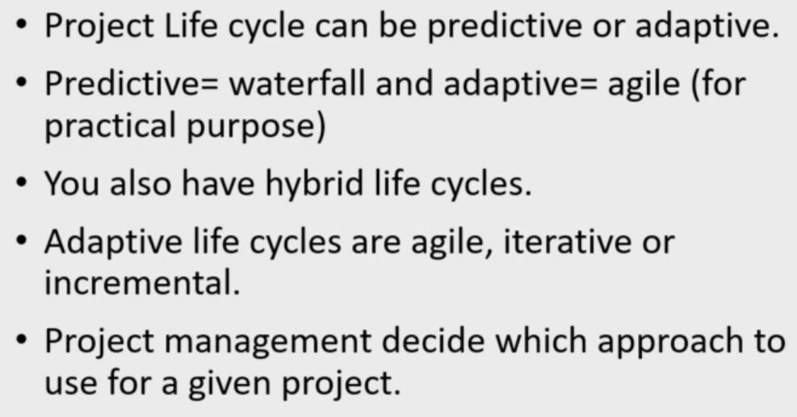
Project life cycle

Slide 45
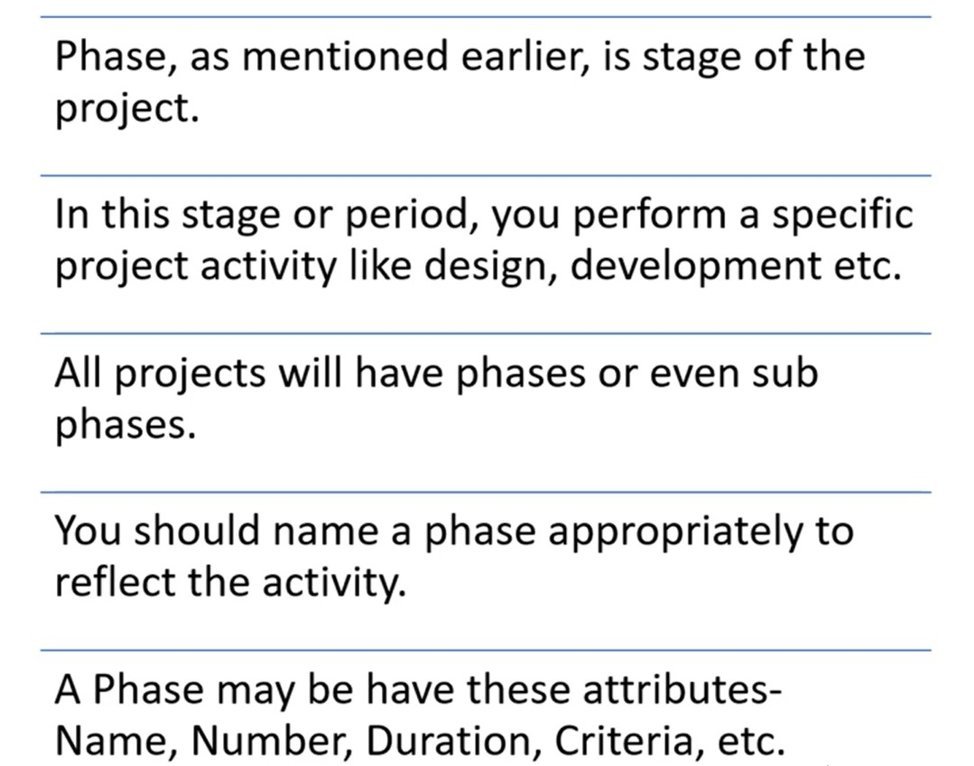
Documenting Phases

Slide 46
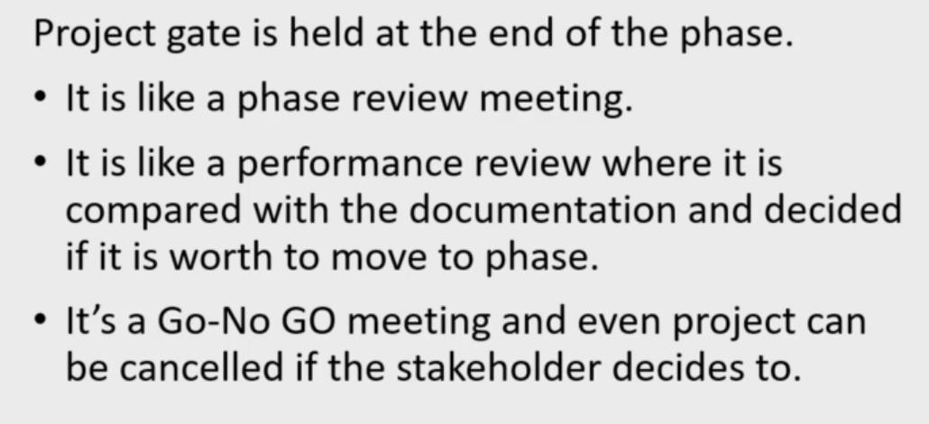
Project/Phase Gate

Slide 47
Project Management Life Cycle
Project initiation
Different aspects of the project are investigated and understood in this phase. These are
Scope of the project
Project constraints
The cost that would be spent
The benefits that would be gained
Based on this understanding, a feasibility study is undertaken to determine whether the project would be financially and technically feasible.

Slide 48
Project Management Life Cycle
Based on feasibility study, the business case is developed.
Once the top management agrees to the business case, the project manager is appointed, project charter is written and finally the project team is formed.
The ground is now set for the project manager to start the project planning phase.
Notes:
Project charter is an important outcome of project initiation phase.

Slide 49
Project Management Life Cycle
Project Planning : Project manager carries out several processes and creates following documents
Project plan: it identifies the project tasks, and a schedule for the project tasks that assigns project resources and time frames to the tasks.
Resource Plan: it lists the resources, man power and equipment that would be required.

Slide 50
Project Management Life Cycle
Financial Plan: it documents the plan for man power, equipment and other costs.
Quality Plan: plan of quality targets and control plan are included.
Risk Plan: it lists the identification of potential risks, their prioritization and action plans that would be taken in case of risk happening.

Slide 51
Project Management Life Cycle
Project execution:
Tasks are executed as per the project plan.
Monitoring and control processes are executed to ensure that the tasks are executed as per plan and corrective actions are initiated whenever deviations are noticed.
Quality of the deliverables is ensured.
This phase completes, once all the deliverables are produced and accepted by the customers.

Slide 52
Project Management Life Cycle
Project Closure:
It involves completing the release of all required deliverables to the customer along with the necessary documentation.
All the project resources are released, supply agreements with the vendors are terminated and all pending payments are completed.
A post implementation review is undertaken to analyze the project performance and to list the lessons learnt for use if future projects.

Slide 53
Traditional vs Modern Project Management Practices
There is a radical change in the basic approach taken by software industry to develop softwares over the last two decades.
Hardly any software is being developed from scratch any more.
Software development projects are increasingly being based on either tailoring some existing product or reusing certain pre-built libraries.

Slide 54
Traditional vs Modern Project Management Practices
Two important goals of recent life cycle models are maximization of code reuse and compression of project durations.
Some other goals include
Fascilitating client feedbacks
Accomodating customer participation
Incremental delivery
Change requests form clients are encouraged, rather than circumvented.

Slide 55
Traditional vs Modern Project Management Practices
These recent trends have changed project management practices in many ways. Some of these are [pg. 23,24,25]
Planning Incremental Delivery
Quality Management
Change Management
Requirement Management
Release Management
Risk Management
Scope Management
Notes:
Planning, prioritizing and controlling different releases of a software.

Slide 56
Key points in lecture
Projects are non-routine - thus uncertain
The particular problems of projects e.g. lack of visibility
Clear objectives are essential which can be objectively assessed
Stuff happens. Not usually possible to keep precisely plan – need for control
Communicate, communicate, communicate!

Slide 57
Readings
[Chapter 1] Software Project Management by Bob Hughes and Mike Cotterell, McGraw-Hill Education; 6th Edition (2009). ISBN-10: 0077122798
[1] F. P. Brooks (1987). “No silver Bullet: essence and accidents of software engineering ”. This essay has been icluded in THE MYTHICAL MAN-MONTH, Anniversarary Edition, Addison Wesely, 1995.

